Slide 1
Acknowledgement of Country
Gippsland Community Legal Service acknowledges the Traditional custodians of the land, their diversity, histories, knowledge and their continuing connections to land, water and community. We respectfully acknowledge the Gunaikurnai, Ngarigo Monero, Bidwell and Bunurong People and their Elders past, present and emerging, who are the Traditional Owners of the land on which our service is located.

Slide 2
Introductions
GCLS
Who are we?
Presenters
Sandra Roennfeldt – presenting at Outer Gippsland P&C Forum
Shan Stevens – presenting at Inner Gippsland P&C Forum

Slide 3
Disclaimer
Today we are providing general legal information only to support your knowledge and information in respect of the Family Law Amendments and other legal issues your clients may experience.
Please call our Intake line or make a referral via our website for advice specific to your clients’ circumstances.
All advice is confidential and legally privileged.
We follow our GCLS Client Charter to ensure accurate and prompt services to clients.

Slide 4
What we will cover
Changes to Family Law
Victims Compensation
Legal issues from Financial Abuse
How to get Help?

Slide 5
Changes to Family Law
Victims Compensation
Legal issues from Financial Abuse
How to get Help?

Slide 6
FAMILY LAW ACT AMENDMENTS
The Family Law Amendment Act 2023 sets out new laws about:
What is in the child’s best interests and what a court must consider when determining parenting arrangements
how separated parents should make decisions about major long-term issues for their children.
The new law commenced on 6 May 2024 and will apply to:
Clients with current proceedings at the FCFCOA still waiting for a final hearing
Clients who have filed Applications for Consent Orders before 6 May and are still waiting for court to consider their application.
Clients with existing parenting orders (will not have them automatically changed) and people should continue to following their orders as usual.

Slide 7
Best Interests – general considerations
Arrangements promoting the safety (including safety from being subject to or exposed to FV, abuse, neglect or other harm for the child and each person who has the care of the child
Any views expressed by the child
Anything else that is relevant to the particular circumstances
of the child
The capacity of each person who has or is proposed to have parental responsibility for the child to provide for the child’s developmental, psychological, emotional and cultural needs of the child
The benefit of the child being able to have a relationship with the child’s parents, and other people who are significant to the child, where it is safe to do so
The developmental, psychological, emotional and cultural needs of the child

Slide 8
Best Interests – Additional considerations right to enjoy Aboriginal or Torres Strait Islander culture
The child’s right to enjoy the child’s Aboriginal and/or Torres Strait Islander culture, by having the support, opportunity and encouragement necessary;
to explore the full extent of that culture, consistent with the child’s age and developmental level and the child’s views
to connect with and maintain their connection with members of their family and with their community culture, country and language
to develop a positive appreciation of that culture
And the likely impact any proposed parenting order
will have on that right

Slide 9
Parental responsibility
Best interests of child/ren
Major long-term decisions
Can have joint parental responsibility or sole parental responsibility for all or some major long-term decisions (for example healthcare, education, religion).
Parents can agree to have joint parental responsibility – formalised in a Parenting Plan or in Consent Orders
Guidance on Joint Decision Making
Parents should consult each other about major long-term decisions in relation to the child (for example healthcare, education and religion)
Parents should make decisions based on the best interests of the child.
Parents do not have to consult if it would not be safe to do so

Slide 10
Parenting Arrangements
Best interests of child/ren
Lives with
Spends time with
No longer mandatory consideration of certain time arrangements
The court can still make equal time care arrangements, or substantial or significant time care arrangements with each parent, if it is in the best interests of the child
Decisions about how much time a child spends with each parent depends on what is in the best interests of the individual child.

Slide 11
How can parents change their final parenting orders?
The court must not consider changing a final parenting order unless:
a significant change of circumstances since the order was made;
in the best interests of the child for the final parenting order to be looked at again.
The court will consider:
1. the best interests of the child; &
2. any matters relevant
If the court is not satisfied that these requirements are met, the orders cannot be changed without the agreement of the other parent or party.

Slide 12
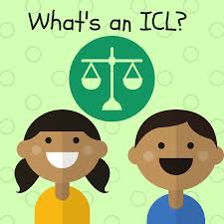
Independent Children’s Lawyers
ICLs will now be required to meet with the child and provide the child opportunity to express a view.
There may be times and ICL would not meet with the child/ren including:
Child who is of very young age
Child who has been exposed to significant trauma where meeting would impact the child
ICL’s also have national standards regarding their practice that will guide when and how they meet with a child
BUT Children cannot be required to express their views in relation to any matter.

Slide 13
Harmful Proceedings Orders
Vexatious litigants will need leave of the court
reasonable grounds to believe that further proceedings would be harmful to the respondent.
Harm may include:
psychological harm or oppression
major mental distress,
behaviour which causes a detrimental effect on the other party’s capacity to care for a child
financial harm.

Slide 14
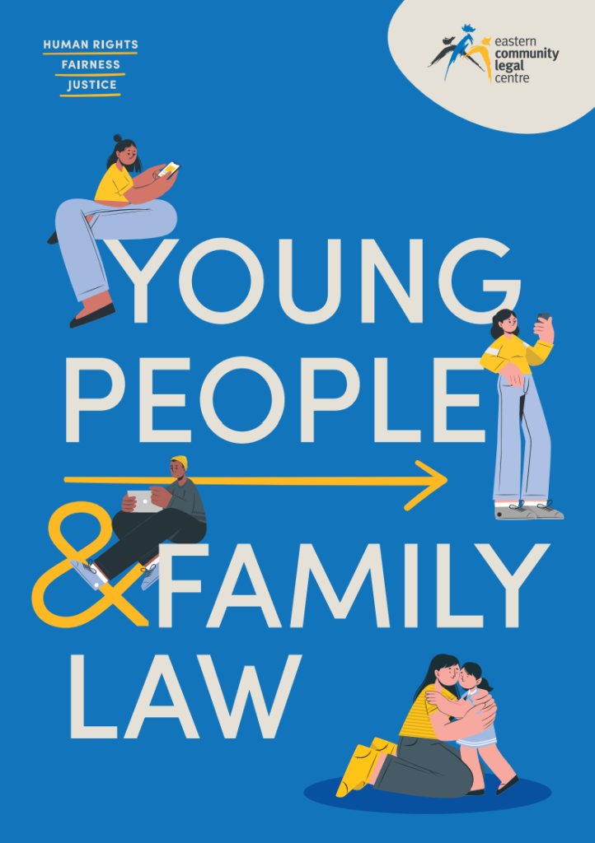
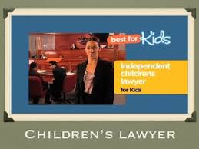
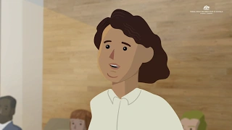
Online Resources about family law for parents and children
Eastern Community Legal Centre - Young People and Family Law Project
Independent Childrens Lawyers - Video and information
FCFCOA - Videos for parents on case management, voice of the child and family violence
FCFCOA Information on Family Law Changes from 6 May 2024

Slide 15
Changes to Family Law
Victims Compensation
Legal issues from Financial Abuse
How to get Help?

Slide 16
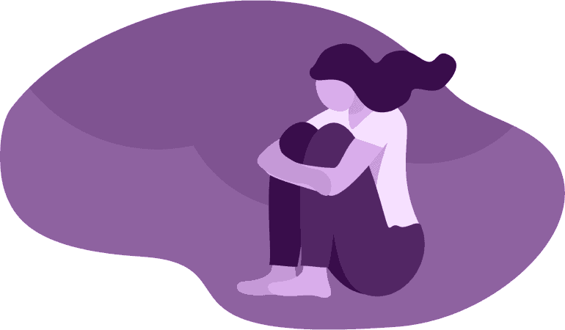
Victims Compensation
Victims Legal Service (VLS) Helpline on 1800 531 566 (toll free) between 9am - 5pm, Monday to Friday.
No Wrong Door – You can contact GCLS and Djirra directly to refer a client also
Free legal advice and support to people who have suffered injury or loss because of a crime and need help to:
seek financial assistance through the Victims of Crime Assistance Tribunal (VOCAT)
get compensation from the person who committed the crime against them
the new Financial Assistance Scheme
Aboriginal or Torres Strait Islander you may also choose to be assisted by an Aboriginal Legal Service provider (Djirra)

Slide 17
Eligibility & types of financial assistance
VOCAT (and the new FAS) provide financial assistance to victims to help them recover from violent crimes.
Primary victims eligible for assistance up to $60,000,
Secondary and related victims are eligible for up to $50,000.
Victims can also receive interim assistance to help with the things they need most straight after the crime
Financial assistance to help with costs such as:
Counselling
Medical expenses
Loss of earnings
Other expenses to help the victim recover

Slide 18
Changes to Family Law
Victims Compensation
Legal issues from Financial Abuse
How to get Help?

Slide 19
Financial Abuse
Common examples of financial or economic abuse include:
Partner refusing to contribute to joint debts (eg. rent, mortgage repayments, car loans, school fees) or pay child support
Partner withdrawing money from a joint bank account or cutting off access to joint accounts
Partner transferring joint property into another person’s name to avoid a Family Law claim
Being coerced to sign documents, take out loans, sign personal guarantees or make false declarations
Identity theft (eg. accounts fraudulently opened by a partner or ex-partner using personal information)
Partner taking control of finances and assets eg. car, social security benefits, superannuation.

Slide 20
How GCLS and Anglicare Victoria Financial Counselling Service can help?
Assist clients to find solutions and pathways to deal with financial abuse which might include:
Application for financial hardship assistance - debt waivers, payment plans)
Consumer complaints about Breaches of the Consumer Credit Law & Breaches of relevant industry guidelines and codes of practice
External dispute resolution schemes (eg. Australian Financial Complaints Authority, Telecommunications Industry Ombudsman, Energy and Water Ombudsman VIC)
Advice about Debt recovery proceedings
Applications for review to Fines Victoria under the Family Violence Scheme
Advice about child support
Basic Advice about family law property settlement transferring or selling property
Advice about FDRS or other forms of lawyer assisted mediation for parenting and property disputes

Slide 21
Changes to Family Law
Victims Compensation
Legal issues from Financial Abuse
How to get Help?

Slide 22
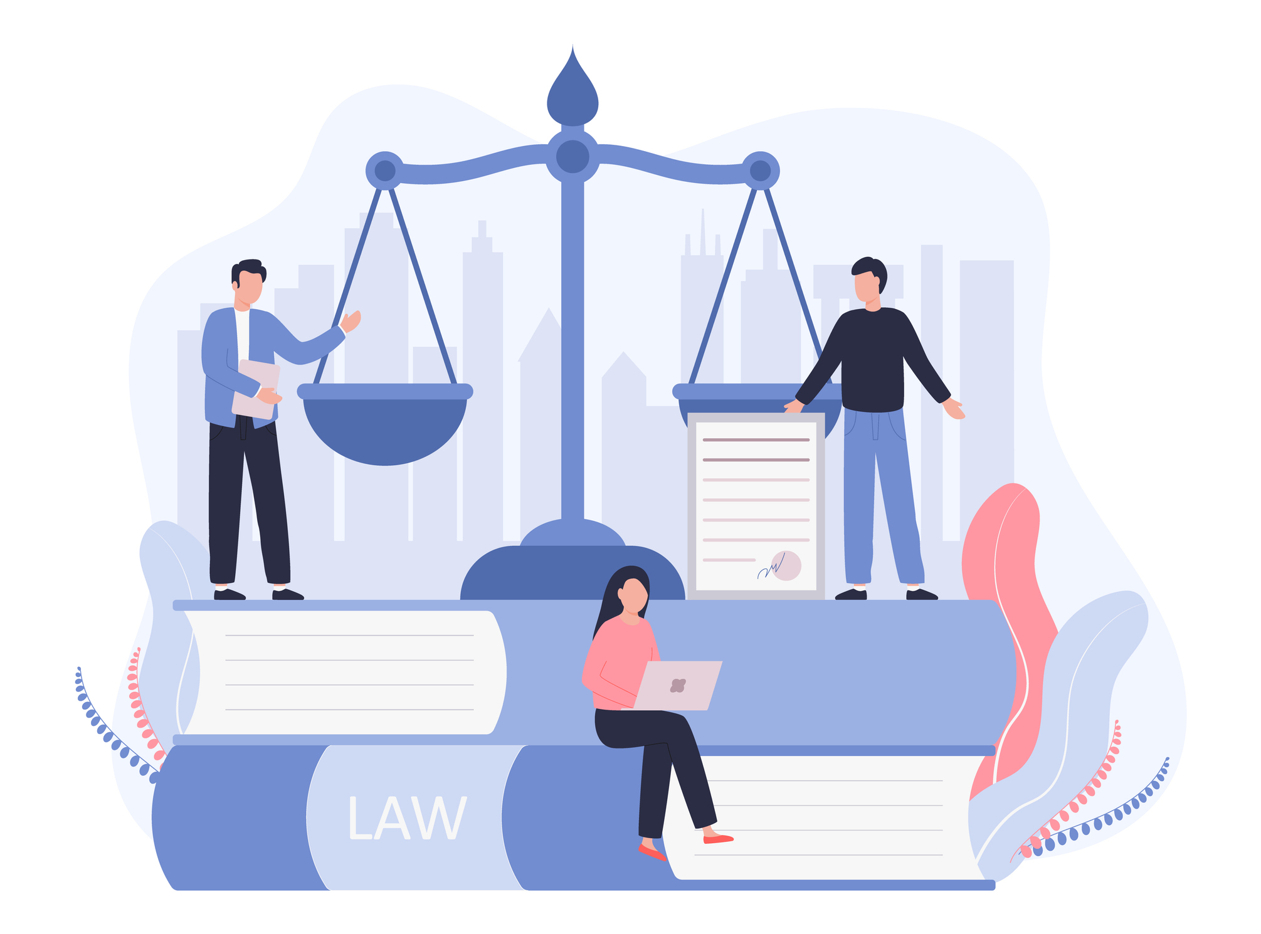
Gippsland Community Legal Service
Intake
1800 004 402
www.gcls.org.au
Morwell │ Warragul │ Leongatha │ Bairnsdale | Wonthaggi
Telephone advice and casework
Duty lawyers at 5 Gippsland courts for IVOs
Outreach to The Orange Door Inner and Outer Gippsland
Outreach to Corinella Neighbourhood House & Manna Gum
Mental Health Tribunal representation
Family Advocacy Support Services Duty Lawyer at FCFCOA Morwell Circuit (each quarter) & fortnightly online at Judicial Registrar Earey’s Morwell List
Legal education and law reform

Slide 23
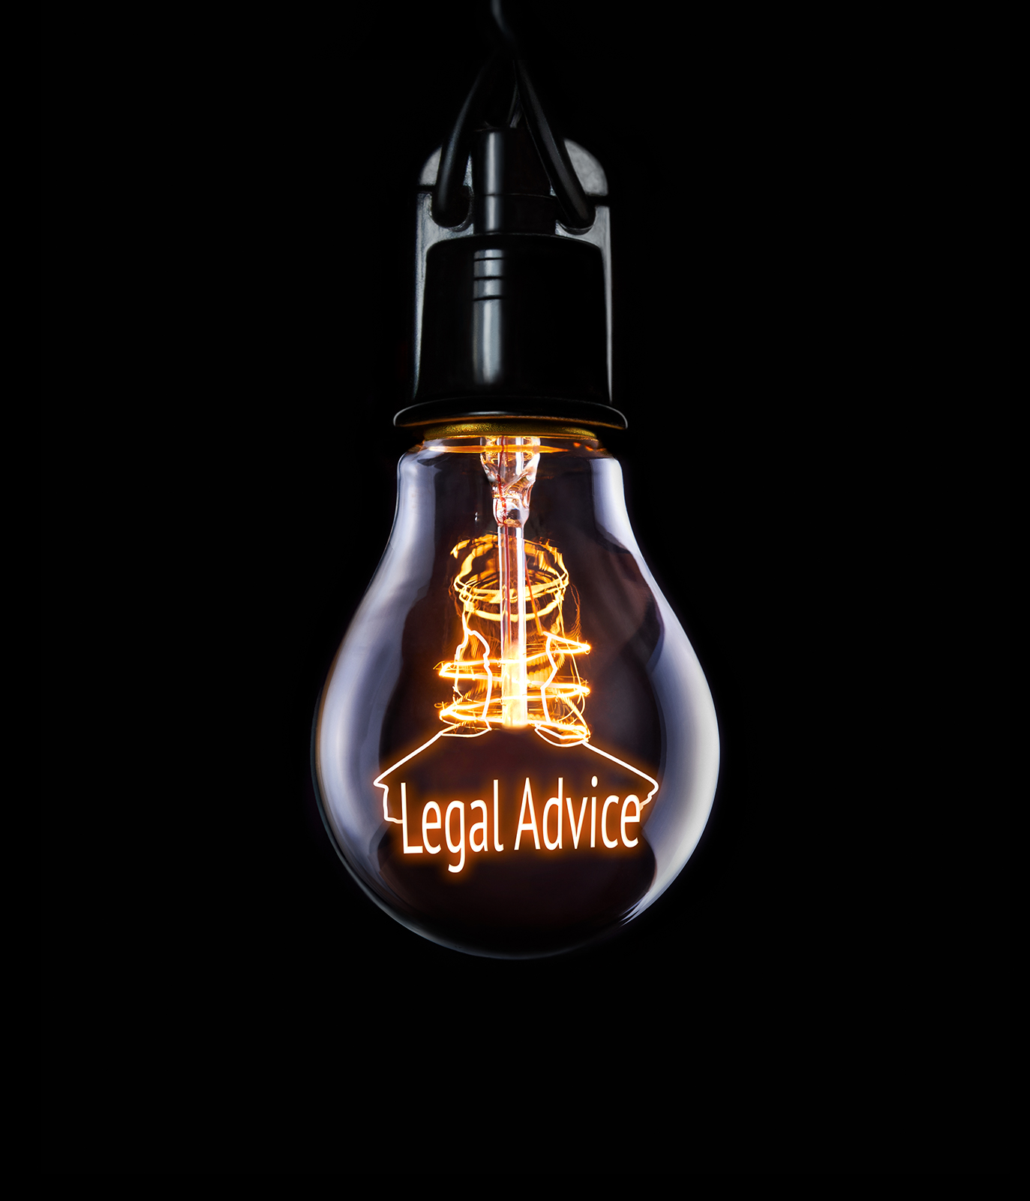
Advance Statements
Consumer credit & Banking Disputes
Change of Name
Child Protection
Child Support
Consumer Complaints
Coronal Inquiry
Debts
Discrimination
Employment
Family Law (Children, Divorce, Property)
Family Violence
Fines and Infringements
Guardianship & Administration
Insurance
Local Government (including planning for Bushfire Project)
Mental Health Tribunal
Motor Vehicle Accident (Property damage)
Neighbourhood Disputes
Police Complaints
Stalking/personal safety
Tenancy (tenants only)
Victims of Crime
Wills, POA, Medical Treatment Decision Making

Slide 24
Casework
Advance Statements
Coronal Inquiry
Debts
Discrimination
Family Violence
Family Law (Children and Divorce)
Fines and Infringements
Guardianship & Administration
Insurance - may assist with out of court negotiations
Mental Health Tribunal
Motor Vehicle Accident (Property damage) – out of court negotiations
Neighbourhood Disputes
Police Complaints
Stalking/personal safety
Tenancy (tenants only)
Victims of Crime

Slide 25
Other legal services
Djirra - 1800 105 303
Victoria Legal Aid Legal Help Line - 1300 792 387
Law Institute of Victoria Find a Lawyer Referral Service - 03 9607 9550
Women’s Legal Service Victoria - 1800 133 302
inTouch (a family violence service working with migrant and refugee women and their communities) - 1800 755 988

