Slide 1
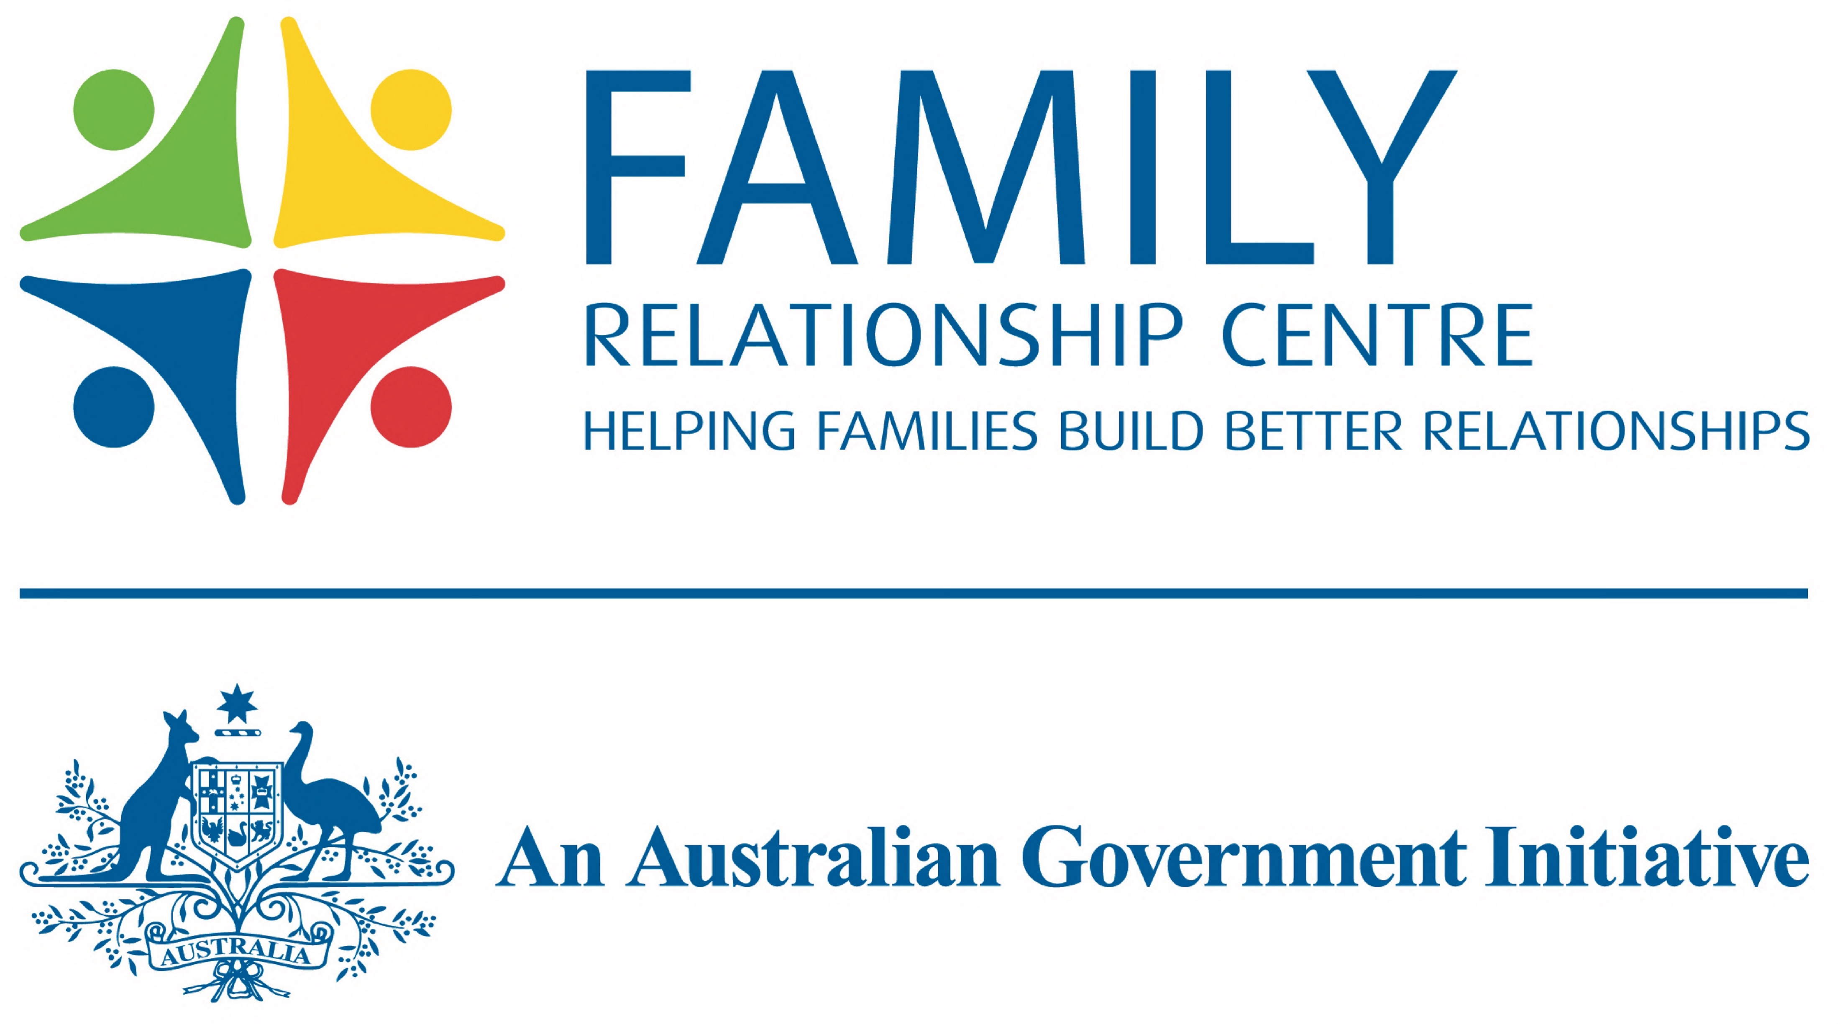
Practice & Connection Forum: Family Violence Legal Supports Family Relationship Centre Childrens Contact Service Better Pride
Presented by:
Kristen Poel
Notes:
Childrens Contact Services are provided by 2 organisations inGippsland- Better Place Australia and Anglicare Victoria . We will make this presentation- aimed at giving you an overview of the role of CCS services together.
Id like to introduce Veronica who will tell you a little about the historys of the services they operate- in Morwell and Bairnsdale.
Veronica talks about the Morwell Service establishment many years ago, its growth and relocation to its current locations. The reasons why the service was extended to Bairnsdale and the service offered there.
Helen introduces self and talks about the Narre Warren service and the newly funded service in Sale.
Not necessary to use the service where the child and parent lives- sometimes it is easly for separated families who live some distance apart tosimply choose the one most convenient for them.

Slide 2
Acknowledgement of country slide with RAP artwork
Notes:
Helen- Acknowledgement of Traditional owners of the land- Guunai Kurnai people and may my respects to the leaders past, present and emerging.

Slide 3
Heading
Better Place Australia Overview and History
Summary
Better Place Australia was established in 1983
Not for Profit - Public Company Limited by Guarantee
Received majority of funding from Commonwealth Government
Provides a range of Family and Community services across 23 locations in Victoria
Over 11,000 clients per annum
Volunteer Board

Slide 5
Heading
Our Services in Gippsland
We offer an online information and support services, phone and video options for service delivery, and a 1800 number that triages callers into:
Family Relationship Centre
Family Counselling
Childrens Contact Service
Relationship Counselling
Family Dispute Resolution – Children
Family Dispute Resolution - Property
Elder Abuse Prevention Support Service
Parenting after Separation Courses
(PAS - Court approved)
Information and Education e.g. Tuning into Kids, Tuning into Teens
Training & Skills Building
Gippsland Family Law Network
We aim to help families understand and resolve conflict, manage their finances, improve communication and grow stronger as a result.

Slide 6
What is Family Dispute Resolution (FDR)
FDR is a process for resolving conflicts between couples and families working through issues arising from separation. Issues such as:
Parenting agreements
Negotiating property matters
It is a process where a trained family dispute resolution practitioner helps people going through separation to identify and consider their options and work towards reaching an agreement
Benefits
Cheaper Quicker Less stressful

Slide 7
FDR and the Court System
Court ordered mediation
Self-initiated mediation
Any stage of separation, even if the parties has started court proceedings.
The court can also order parties to go to family dispute resolution at any time throughout the court process.
If parties are seeking court orders about children (parenting orders), they must try FDR first
Except some situations – family violence or child abuse, or it is urgent. Legal advice is recommended.
If parties are seeking court orders about property, the court may get them to try FDR too.

Slide 8
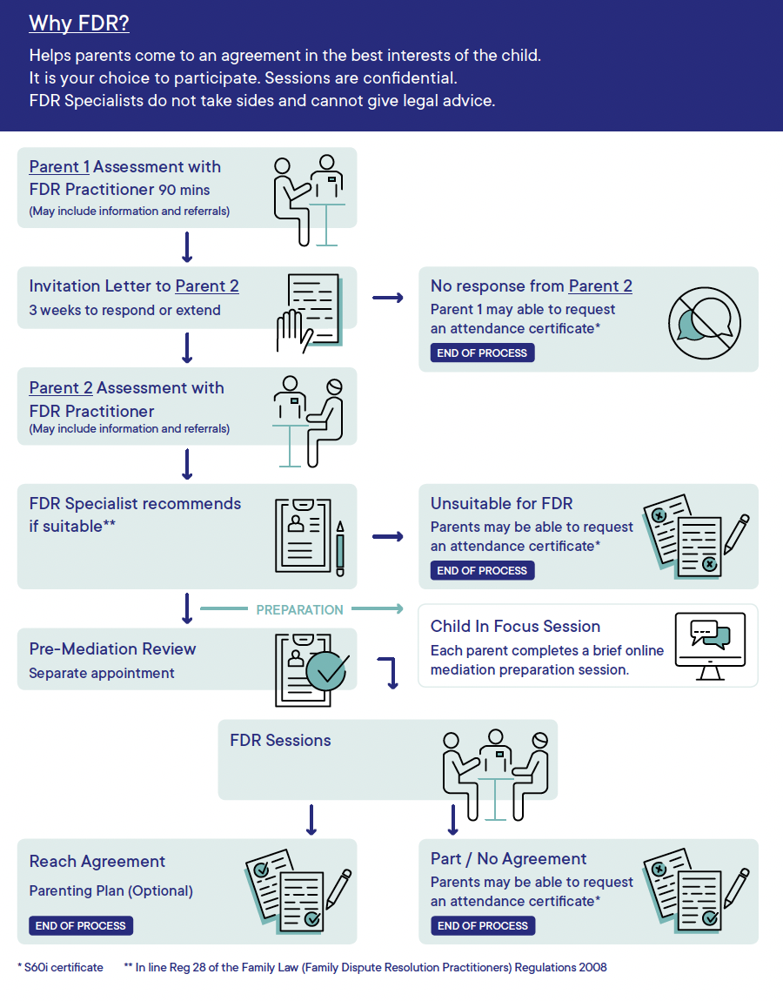
The
FDR
Process

Slide 9
Heading
Family Violence and Mediation
Family Violence Intervention Orders (FVIO) and Family Court Orders (FCO)
In order to ensure we can provide mediation services; we must sight the FVIO & FCO before we invite the other party.
The FVIO must include the 3 clauses enabling the parties to participate in mediation
The respondent may:
(a) negotiate child arrangements by letter, email or text message; or
(b) communicate with a protected person through a lawyer or
mediator; or
(c) arrange and/or participate in counselling or mediation.
Interaction between Orders
A parenting order overrides a FVIO, unless a Magistrate temporarily revives, changes or suspends parenting order.
Often, FVIOs have a clause that allows for arrangements.
The respondent may do anything that is permitted by a Family Law Act order,
a child protection order or a written agreement about child
arrangements

Slide 10
Heading
Property Mediation Process
Process prior to Mediation similar to children's process (with the addition of consideration of the complexity of asset pool).
Parties informed at each stage of the process that FDRP’s are independent, neutral and impartial. FDRP’s do not provide legal advice.
Parties are required to get legal advice. We recommend parties engage actively with their lawyer and other professionals such as accountants throughout the process.
Parties must be prepared to provide full and frank financial disclosure.
The Mediation Process is a 2 step process involving 2 separate appointments:
1:1 preparation appointments
Joint/shuttle FDR (s)
(information shared from 1:1 prep appointments, proposals exchanged, agreements written up)

Slide 11
Heading
Property Mediation Process
The Property Mediation process:
Developing an agreed asset and liability list
Questions and clarifications on contributions and future needs
Offers explored regarding to the split of the asset pool.
When advice is needed.
Agreements reached.
Referrals made.

Slide 12
About Children’s Contact Services
Children’s Contact Services are places that support families post-family separation.
Children can have safe and supported supervised visits and facilitated changeovers with parents and family members.
Children, parents and family members may also be referred to other services that will support their well-being during their time with us.
Notes:
Speak about Separation
-Can be hard on everyone in the family
-Can be especially hard on children who may be conflicted, inplacted by FV or conflict, have had to move residence and possibly schools
Research suggests that children who are well supported through separation can do just as well as other children but there are risks that emerge over this period. Ongoing exposure to conflict, paraental alienation and a lack of emotional support are risks.
Childrens Contact Services are child focused and try to minimise the impact of separation on the child. The safety of the child is is out primary focus.
We will talk a little about the 2 streams of service that we offer before speaking a little more about our risk assessment processes, how we support families and our role within the family law environment.

Slide 13
What Is Supervised Contact?
A trained Contact Worker being present at all times when contact occurs between a parent and their child.
It may be court ordered or be the result of an agreement/Parenting Plan between the parents.
Common reasons for supervised contact might include family violence, mental ill health, drug/alcohol misuse or re-establishment of parent/child relationship.
The role of the Contact Worker is to support the contact and intervene where necessary to safeguard the interests of the child.
The Contact Worker makes observational notes that may be provided to the Court in Family Law Proceedings

Slide 14
What is Change over?
Supervised change-over involves a trained Contact Worker assisting with the changeover of children between the separated parents.
Conflict can occur when the child is being transitioned between the care of parents and using the CCS to help manage things can reduce stress for all family members.
Changeovers may be court-ordered or be the result of an agreement/Parenting Plan between the Parents.
Parents generally do not need to have any contact with each other
Staff will write observational notes about the changeover that can be provided in family law proceedings.

Slide 15
Safe. Neutral. Child-focused.
Affordable
Minimal wait time, flexible timings (including weekends)
Child-focused
Safe and facilitative environment
Access to parenting programs

Slide 16
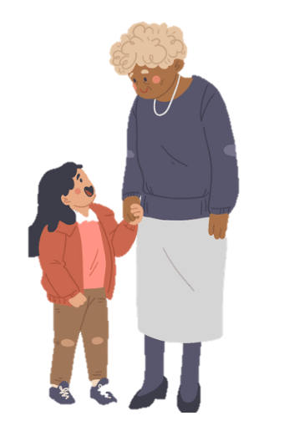
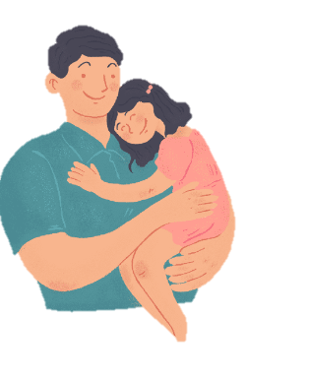
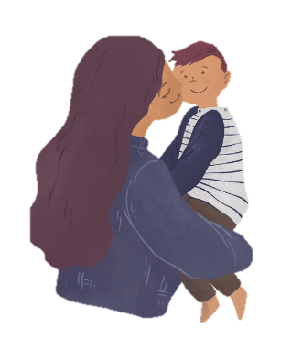
Service Delivery
Contact Visits/Changeovers are scheduled at a suitable time for the family.
Most families attend fortnightly.
Contact Services encourage families to work towards other arrangements where this is safe- this allows new families to benefit from the service.
We complete factual reports to assist Parents and the Family Court to make informed decisions regarding future arrangements for children.

Slide 17
Referral and Intake Process
Parents, a Lawyer or an Organisation can contact the local CCS for information.
The service requires application forms from BOTH parents to proceed to the Intake and Assessment stage.
The Assessment stage involves an interview with both Parents and an explanation of the Service Agreement.
The Assessment stage involves a consideration of risk to ensure we can deliver a safe service for everyone.
A child orientation occurs on site and workers are trained to gather and respect the views of the child.

Slide 18
Locations in Gippsland
Morwell Anglicare Victoria
Sale Better Place Australia
Bairnsdale Anglicare Victoria
Narre Warren Better Place Australia
We encourage parents to attend the contact service that is closest to where the child lives.

Slide 19
Heading
Better Pride
Better Pride Team
Our Better Pride Practitioners identify as members or allies of the LGBTIQ+ communities and have a depth of experience working with people of all ages.
Commitment to providing a safe, confidential, and non-judgmental environment to support you through life experiences and decisions. We want to help you increase self-awareness, find ways to better care for yourself, and support with relationships.
Recognising that everyone’s journey is unique, we are dedicated to assisting you in reaching a better place with respect and understanding.
Services
Family Dispute Resolution
Counselling
Support in developing Donor Agreements
Rainbow Tick Accredited

Slide 20
How people can access our service
Call 1800 639523
Enquire through our enquiry form: betterplaceaustralia.com.au/make-an-enquiry/
For more information, visit betterplaceaustralia.com.au

