Slide 1
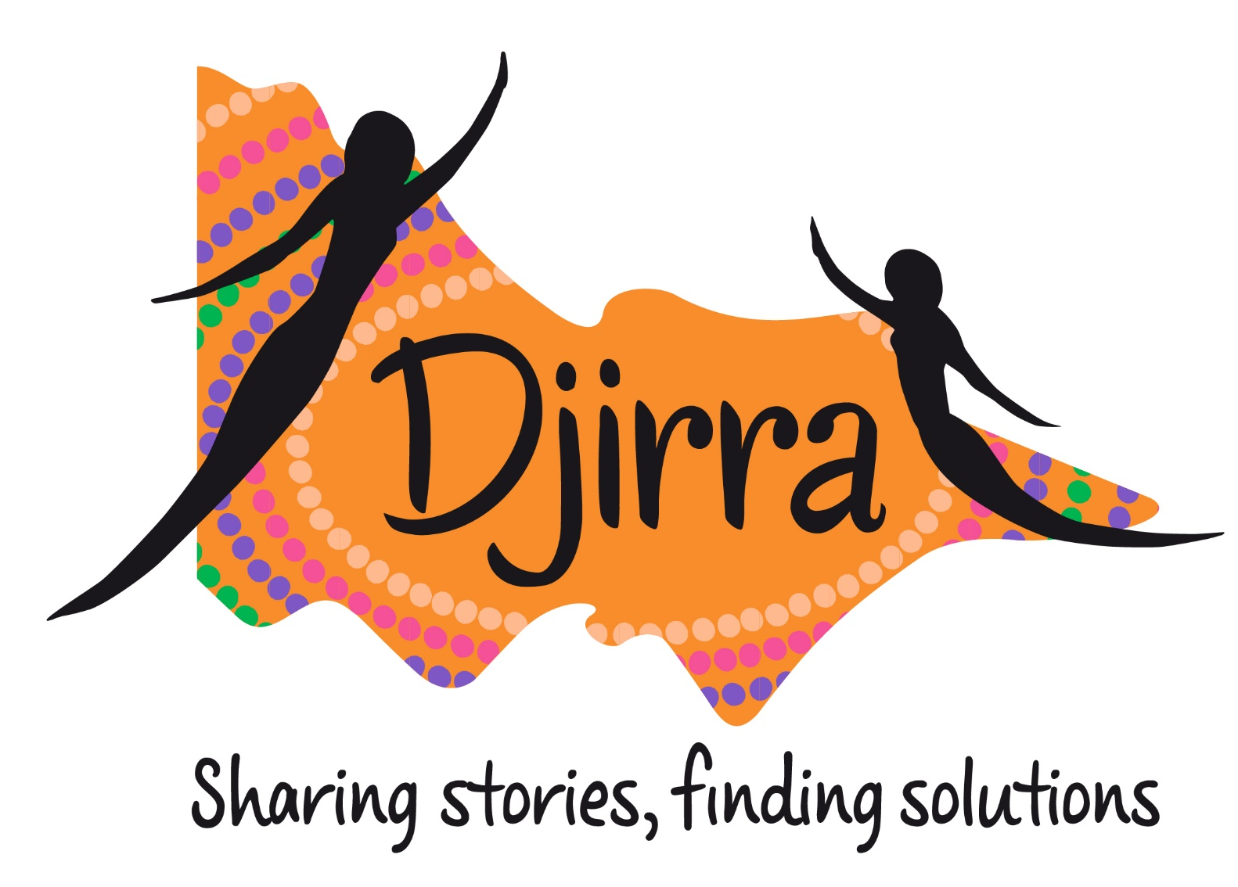

Slide 2
Djirra proudly acknowledges Aboriginal people as Australia’s First Peoples and as the traditional custodians of the land and waterways on which we are privileged to live and work.
We pay our respects to all Elders past and present.
This always was, and always will be, Aboriginal land.

Slide 3
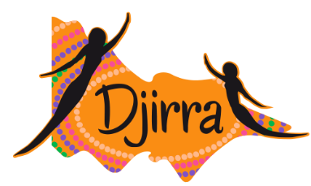
Djirra is an Aboriginal Community Controlled Organisation (ACCO), with over 22 years’ experience finding solutions and sharing their stories, journeys and experiences.
Djirra delivers holistic, culturally safe, specialist family violence services and programs including:
Cultural, wellbeing and personal development workshops, and practical support through our Koori Women’s Place and signature EIP programs (also offered to women in prison)
Community education policy and advocacy work (including cultural projects)
Family violence case management services
Legal assistance with IVOs, child protection, family law and victims of crime matters

Slide 4
Djirra Legal (Aboriginal Family Violence Legal Service) is a program of Djirra, offering legal and non-legal support to Aboriginal and Torres Strait Islander people, and non-Aboriginal parents/carers of Aboriginal and Torres Strait Islander children, who have experienced or are experiencing family violence.
At present, we are a team of 36 Lawyers and Paralegal Support Workers (PLSW). We have 9 offices across Victoria.

Slide 5
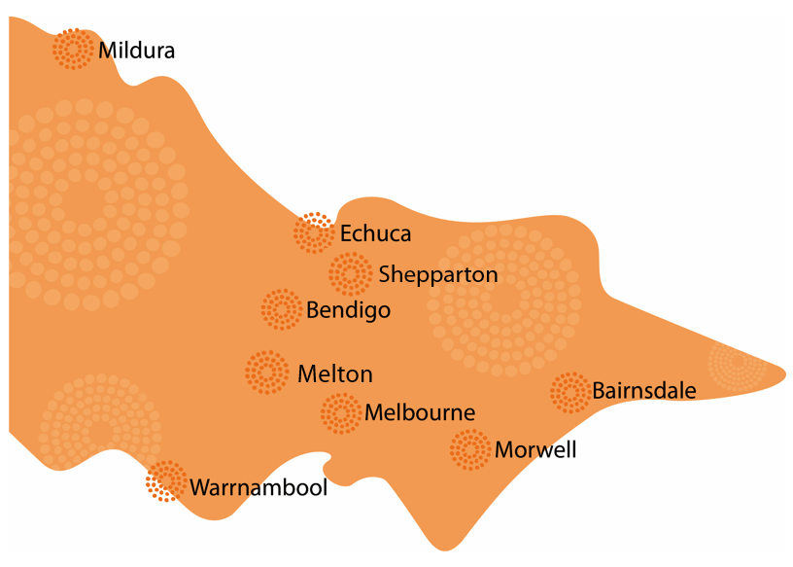
Djirra Legal can generally assist with legal matters which are in Victorian courts. However, we can assist people with referrals to legal services interstate, where appropriate.

Slide 6
Djirra is a place where culture is shared and celebrated, and where practical support is available to all Aboriginal women.
However, Djirra Legal’s eligibility criteria is non-gendered. Djirra Legal supports Aboriginal people experiencing, or having experienced, family violence. And in acknowledging that family violence is a gendered issue, we note that most of our clients do identify as women.
Djirra Legal will also support Aboriginal women who have been misidentified in the legal system.
Most of the people we work with are adults, however we do assist children in Victim of Crime Compensation matters, where we are also assisting the parent/guardian with a claim.

Slide 7
Family Violence Intervention Orders (not incl. Personal Safety Intervention Orders) | Child Protection
Family Law (Parenting & Divorce) | Victims of Crime (Compensation)

Slide 8
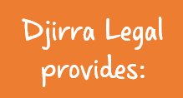
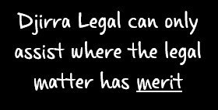
1. Legal advice – one off meeting with a lawyer who provides preliminary advice;
2. Ongoing representation – where a legal file is open, and a lawyer assists with negotiations, court appearances, etc.
3. Non-Legal support – client and court supports, emergency relief, referrals, etc.
Merit means that it is a ‘good case’; that is, where the circumstances show that there is good evidence available to advocate for what the client is seeking.
At times, it can be difficult to assess whether a case has merit. However, we may still be able to act in these circumstances.

Slide 9
Djirra’s Paralegal Support Workers (PLSW) provide holistic wrap around support to clients. PLSWs can provide continued assistance in matters where there is an ongoing legal file open.
The non-legal support role is two-fold:
PLSWs provide support to clients directly related to their legal matter; and
PLSWs provide administrative support to lawyers.
Client support could include:
Emotional support throughout the legal matter
Court support (i.e. attending Court with clients)
Safety planning
Attending external meetings (incl. DFFH, VACCA)
Support with dealing with Police (incl. reporting breaches)
Support with compliance of Court Orders (incl. help organising drug testing, referrals to ensure linked in with services)
Referrals (i.e. housing, family violence services, mental health services (incl. counselling))
Emergency relief (i.e. food and petrol vouchers, emergency accommodation & travel, etc.)
If a client needs supports beyond what PLSWs can provide, they will be referred to a service that can provide case management (incl. internal referrals to Djirra’s ISS Team).

Slide 10
There may be times when Djirra Legal cannot assist a person.
There are a few different reasons for this, including:
A conflict of interest exists;
A client does not fit the eligibility criteria;
Another service is more appropriate/specialised – such as expert legal services;
The legal needs of the client are not in our areas of work; or
A client may not be eligible for legal aid funding.
Note: This will not always prevent our ability to assist, however there may be instances where we cannot act for someone all the way to a hearing, if legal aid does not fund the matter.

Slide 11
Djirra Legal also has a Prison Support Program (PSP) which supports women who are incarcerated in Dame Phyllis Frost Centre and Tarrengower Women's Prison.
Our PSP Lawyer and PLSW support women with the same legal issues as our wider legal service (family violence, family law child protection, victims of crime), through weekly outreach.
Support is provided both in prison and post-release.

Slide 12
Family Violence Intervention Orders
There are two types of intervention orders that can be ordered in the Magistrates' Court:
personal safety orders (PSIVOs); and
family violence intervention orders (FVIVOs).
FVIVOs apply to situations involving family members or people in a relationship. They operate under the Family Violence Protection Act [2008].

Slide 13
FVIVO Parties
Applicant: The person (or organisation) that applies for the FVIVO
Affected Family Member: Person (or people) protected by the FVIVO
Respondent: Person that the FVIVO applies to
FVIVO length is a matter decided by the Magistrate, although each party can make their views about the length clear to the Court.

Slide 14
FVIVO Conditions
FVIVOs can contain a range of conditions – some allow contact between parties, and some prohibit contact.
Aside from contact, some other example conditions stop the Respondent from:
Committing family violence;
Intentionally damaging property;
Attempting to locate, follow or keep the AFM under surveillance;
Publishing material about the AFM on the internet;
Approach or remain within X metres of the AFM, their home, or any other place where they live, work or attend school/childcare; or
Getting another person to do anything that they must not do under this order.

Slide 15
FVIVO Exceptions
FVIVOs can contain exceptions, particularly where parties have children.
It is important for clients to seek legal advice about exceptions, as they are often misinterpreted.
Exceptions can include:
Being able to do anything permitted by a Family Law Act order, a child protection order or a written agreement about child arrangements;
Negotiate child arrangements by letter, email or text message:
Communicate through a lawyer or mediator; or
Arrange and participate in counselling or mediation.

Slide 16
Breaches
If a Respondent breaches the conditions of a FVIVO, the police can charge them with a criminal offence.
It is important that the breach is reported to police. Breaches are also often misinterpreted, and
While not essential, it can be helpful for clients to have a support person to attend the police station with them.

Slide 17
Misidentification
The term ‘misidentification’ means that the person experiencing violence is misidentified as the person using violence.
Misidentification is way that people using violence can use of the legal system to perpetrate further family violence, by controlling and preventing affected family members from accessing the protections of the legal system.
The consequences can be life altering, and in extreme cases, life threatening.

Slide 18
Undertakings
An undertaking is an agreement between the Applicant and the Respondent.
The undertaking also includes conditions that the Respondent has agreed to. The Respondent has to sign it as a promise that they will follow the agreement.
An undertaking is not an order of the Court and the police cannot enforce it.
If the Respondent does not follow the undertaking, Applicants can re-apply for a FVIVO.

Slide 19
Child Protection
Family violence can be a protective concern in respect of Child Protection.
Family violence and intervention orders interplay with this area of law meaning that it is important for AFMs to seek legal advice about how this may affect them.

Slide 20
Intervention Orders:
Police Applications
Cross-applications
Misidentification
PLSW support to report breaches and Court support
Child Protection:
Can provide advice, assistance and advocacy before the matter is in Court and at Court
PLSW support:
Support at CTM, AFLDM etc.
External referrals – e.g. Counselling
Court support
Family Law:
Urgent parenting advice for example, where family violence, flight risk or breach of Orders

Slide 21
To make a referral to any of the Djirra services, dial 1800DJIRRA during business hours. Alternatively you can email us: AFVLS: info.afvls@djirra.org.au
ISS: support@djirra.org.au
KWP: kwp@djirra.org.au
1. Client name and DOB
Information about the matter to save the client repeating themselves.
2. Other parties names and DOB (incl. children & related parties)
3. Legal matter type
4. Contact details and if safe to text/call/email
Any documents you have consent to provide e.g. IVO/Application, safety plan, L17.
If matter is high risk.
Urgent dates e.g. Court date, IVO expiry, children due to go to other parent.

Slide 22
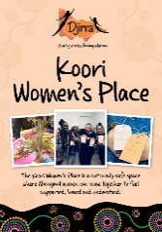
Djirra’s Koori Women’s Place welcomes Aboriginal women to visit and:
Join in cultural, wellbeing and social activities face-to-face or through our online workshops
Unwind and take a break
Get information about upcoming Sisters Day Out, Dilly Bag and Young Luv workshops
Access practical support (incl. food, clothing & toiletries)
Connect with other Djirra services
Access our visiting services to get information and advice

Slide 23
Djirra offers a range of workshops in Melbourne and regional areas:
Sisters Day Out® is a one-day wellbeing workshop held regularly in community, where Aboriginal women support each other, get information about legal rights and options, and engage with mainstream and Aboriginal support services.
Sisters Day In is a specialised version of Sisters Day Out and is delivered to our sisters in Dame Phyllis Frost Centre and Tarrengower Prison.
Dilly Bag is a residential on country gathering of Aboriginal women that draws from cultural principals to inform Aboriginal women’s ways of being in order to live a culturally safe and meaningful lifestyle.
Young Luv® is designed for young Aboriginal women, aged 13 to 18. It is a half day activity facilitated by Aboriginal women to engage Aboriginal teenagers in a culturally safe space where they can talk about, reflect on, and better understand important issues affecting their lives. This workshop aims to equip young women with information and skills to challenge unhealthy relationships, and to practise positive and safe behaviours.

Slide 24
Djirra’s Individual Support Services offer the following support to Aboriginal women:
Family violence case management
Intensive support
Drug and alcohol support and counselling
Support with housing, mental health, finances and employment issues and referrals
Pre and post prison support

