Slide 1
Family Advocacy and Support Services (FASS)
Presentation to Gippsland Family Violence Alliance- practice and connection forums
Bairnsdale 17th July, Leongatha 18th July 2024

Slide 2
What is FASS?
FASS is an integrated service providing free duty lawyer assistance and holistic social supports for people impacted by family violence with matters in the family law courts.
Established in 2017 at Melbourne and Dandenong registries of the Federal Circuit and Family Court of Australia (FCFCOA)
Expanded to FCFCOA circuit locations in Victoria in late 2022
National program – administered by Legal Aid Commissions in all states

Slide 3
How does FASS operate?
At Melbourne and Dandenong FCFCOA registries:
Full time service (9am-4:30pm, Monday-Friday when Court sitting)
In-person and remote assistance
At FCFCOA circuit locations in Victoria:
Available during circuit sittings and fortnightly JR lists
In-person and remote assistance

Slide 4
Who can access FASS?
Clients are eligible for FASS services if:
They or a family member have experienced, used or are alleged to have used family violence in the relationship; and
They need assistance with family law (and related child protection or family violence IVOs)
There is a sufficient nexus with family law proceedings.
FASS services are not means tested.

Slide 5
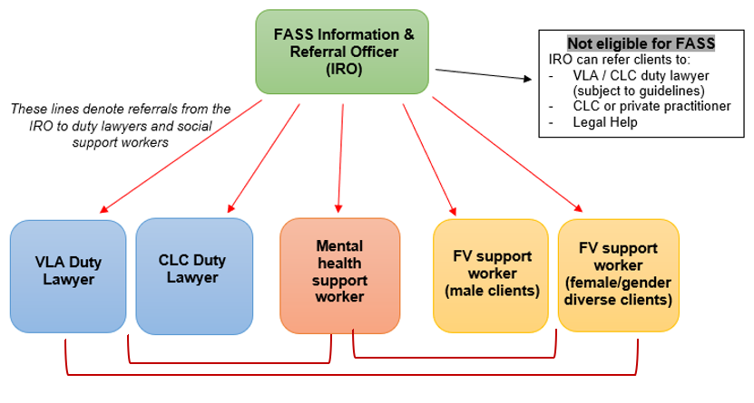
How does FASS operate?

Slide 6
What do the FASS roles involve?
Duty Lawyer Procedural and/or advice Document preparation Appearances Referral for ongoing assistance (legally aided or private) | Family Violence Worker MARAM risk assessment Safety planning Referrals for ongoing support Emotional support | Mental Health Worker Suicide risk assessment Mental health safety planning Referrals for ongoing support Emotional support

Slide 7
Who is the Morwell circuit FASS team?

Slide 8
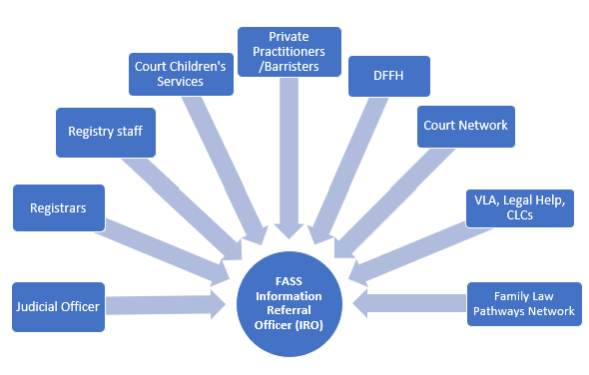
How to refer to FASS
FASS telephone line (03) 8610 9803 In-person referrals: At Melbourne & Dandenong FCFCOA registries During in-person circuit sittings

Slide 9
Example case studies
Interim FVIO Family law parenting proceedings – court date in a few days Client does not have a lawyer | Past family violence Family law proceedings – final hearing Client has their own lawyer | Recent separation, allegations of FV Other parent failed to return child after agreed time No court date or court orders

Slide 10
FASS Contacts
Referrals to FASS
FASS phone line on (03) 8610 9803 for triage, assessment & referral
Questions about FASS program
VLA Family Law Projects team - fyclprojects@vla.vic.gov.au

