Slide 1
Settlement Engagement & Transition Support Program (SETS)
Nikki McNeilage

Slide 2
What is the Settlement Engagement and Transition Support (SETS) program?
The Settlement Engagement and Transition Support (SETS) program is a FREE government initiative aimed at assisting newly arrived migrants, refugees, and humanitarian entrants in their settlement process within Australia
Facilitate the successful integration of migrants into Australian society.
Provide essential support services to help newcomers navigate various aspects of settlement.
Promote social inclusion and community participation among migrants.
Gippsland wide
LCHS & GMS ( post 1st July)

Slide 3
Who are your local SETS team?
LCHS has 3 SETS workers
Sandy Mullen: Case worker – Baw Baw, Latrobe, Bass coast and south Gippsland (.8 FTE)
2. Nikki McNeilage: Case worker – Latrobe, Wellington, East Gippsland (1 FTE)
3. Elise Tulloch: SETS project officer, Gippsland Wide (.4)

Slide 4
What can SETS workers do to assist your clients?
The SETS role is to support recently arrived migrants and refugees in their transition to living and thriving in Gippsland. We can do this by:
Provide low to medium case management
Advocacy & Capacity building
Using a client centered and strengths based approach
Shared case management with external stakeholders
Referral to education & training ( including AMEP/ English) TAFE and university
Guide clients to getting overseas qualifications recognized
Assistance in obtaining employment, referrals to employment specialists and the Skills and Jobs Centre,
Exploring volunteer opportunities
Share local knowledge and information about housing, health and wellbeing, transport, sporting clubs and connection to community leaders
Providing information sessions about current and emerging trends ( Vic emergency ap, CPR, Life saving victoria, Tax)
Referrals to multicultural friendship groups and activities
Assistance with filling out paperwork and navigating the health care, legal and social service system
Linking to other services such as immigration, family violence, mental health when out of the scope of our role

Slide 5
What SETS Workers can NOT do:
Offer Immigration Advice
It is an offence for a person to give immigration assistance in Australia unless that person is a registered migration agent, legal practitioner or exempt person. The penalty for providing unlawful immigration assistance can be up to 10 years imprisonment.
If you have a client requiring immigration advice or assistance you can:
Refer them to the immigration website
Refer to a migration agent or immigration lawyer
Additionally:
We are NOT family violence specialists OR housing workers, however we can support clients while being linked to a specialist family violence service to support capacity build in the areas of education, employment, community support etc.

Slide 6
Who is Eligible & Cost:
We can help anyone who:
Arrived in Australia less than 5 years ago *
Lives in the Gippsland region
Has an eligible visa to settle in Australia
There is NO cost to this service

Slide 7
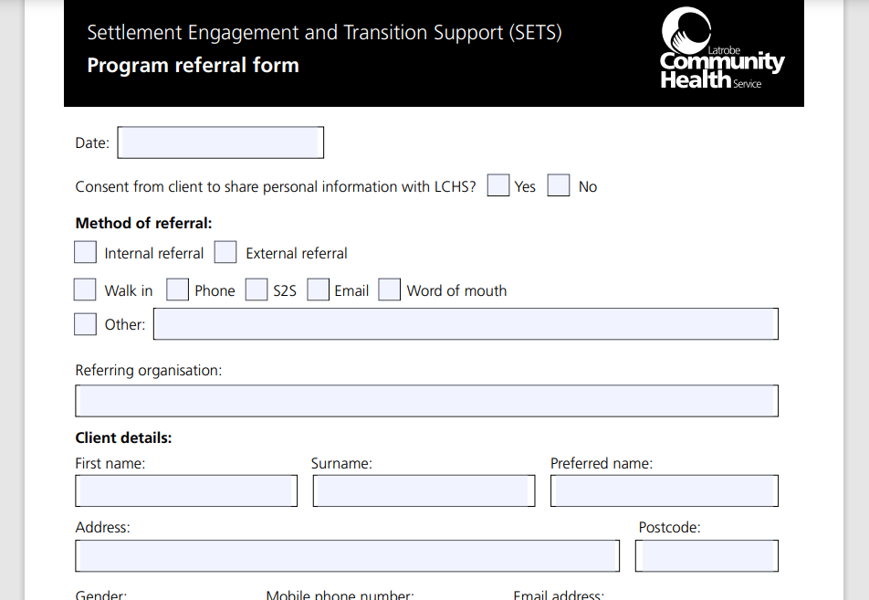
How do you refer to our program?
You can self refer or be referred by a external service
If you have clients that you feel would benefit from this program:
Discuss the program with your client & gain consent
Please send a completed referral form to sets@lchs.com.au
A copy of our referral form will be shared via email at the conclusion of todays event
Clients will be contacted within 3 business days of the referral being received. Currently a 2-3 week waiting list

Slide 8
Handy Hints when working with interpreters:
Book a qualified interpreter:
Ensure the interpreter is accredited and experienced in the relevant language and context.
Brief the interpreter:
Before the session, brief the interpreter on the context, purpose, and any specific terminology or concepts.
Use a professional interpreter:
Avoid using family members or friends as interpreters, as this can lead to conflicts of interest and confidentiality issues.
Work with the interpreter:
Before you start the appointment, confirm that the client and interpreter can understand each other. Speak clearly and at a moderate pace, allowing the interpreter to keep up with the conversation
Check for understanding:
Regularly check with the client to ensure they understand the interpretation, and also encourage the client to ask questions with the aid of the interpreter
Notes:
1. Book a qualified interpreter: Ensure the interpreter is accredited and experienced in the relevant language and context. When booking, please ensure you ask the client what language or dialect they require, if they prefer male or female, phone or face to face.
2. Brief the interpreter: Before the session, brief the interpreter on the context, purpose, and any specific terminology or concepts.
3. Use a professional interpreter: Avoid using family members or friends as interpreters, as this can lead to conflicts of interest and confidentiality issues. (Also check that the client doesn’t know the interpreter you have booked – this can happen in regional settings where face to face interpreters are limited)
4. Work with the interpreter:
Before you start the appointment, confirm that the client and interpreter can understand each other. Speak clearly and at a moderate pace, allowing the interpreter to keep up with the conversation. Do not talk for longer than 4 sentences, so the interpreter can interpret correctly and efficiently.
When speaking face to face, do not face the interpreter and talk directly to them, face the client and have a conversation with them.
5. Check for understanding: Regularly check with the client to ensure they understand the interpretation, and also encourage the client to ask questions with the aid of the interpreter

Slide 9
Tips when working with people for diverse backgrounds:
If you are NOT aware, ASK
Avoid making assumptions based on stereotypes.
Ensure language support services such as interpreters, translated materials, and bilingual staff are available to facilitate effective communication.
Use clear and simple language, avoid jargon, and be mindful of non-verbal cues.
Cultural Awareness and Competency: Educate yourself about the cultures, beliefs, values, and customs of the communities you are serving. This can help you understand their perspectives and build trust, A great website that you can use is Home — Cultural Atlas (sbs.com.au) this website can teach you about cultures, beliefs, customs and give you other important information
Time: People may not realise that lateness might suggest a lack of commitment or have serious consequences.
You can respectfully address this by making clear the importance of punctuality and working with them to manage this
Notes:
Cultural Awareness and Competency: Educate yourself about the cultures, beliefs, values, and customs of the communities you are serving. This can help you understand their perspectives and build trust, A great website that you can use is Home — Cultural Atlas (sbs.com.au) this website can teach you about cultures, beliefs, customs and give you other important information
Language Support: Ensure language support services such as interpreters, translated materials, and bilingual staff are available to facilitate effective communication.
Respect and Valuing Diversity: Treat all individuals with respect and value the diversity of their backgrounds. Avoid making assumptions based on stereotypes.
Cultural Sensitivity in Communication & Active listening: Use clear and simple language, avoid jargon, and be mindful of non-verbal cues. Adapt your communication style to meet the needs of the individual. Listen carefully to the concerns, needs, and preferences of individuals from CALD backgrounds. This helps in understanding their perspectives and providing appropriate support.

Slide 10
Handy Links and resources to assist you in your roles:
Tips for working with culturally and linguistically diverse people:
Tips-for-Working-with-Culturally-and-Linguistically-Diverse-CALD-Communities.pdf (psplearninghub.com.au)
A place to find out about peoples culture, customs and beliefs
Home — Cultural Atlas (sbs.com.au)
Information for people experiencing family violence and have visa concerns:
Family Violence Provisions (homeaffairs.gov.au)
In language supports for people experiencing family violence and are on temporary visas:
How we can help you (homeaffairs.gov.au)
Tips for working with interpreters:
Working with interpreters | vic.gov.au (www.vic.gov.au)
Department of home affairs website: Info on visas, citizenship and migration
Department of Home Affairs

Slide 11
Questions?
Thank you for your time today, if you have any additional questions please contact the SETS team at:
E: Nicole.McNeilage@lchs.com.au
M: 0498330999
Or sets@lchs.com.au

