Slide 1
Strengthening Communities Project Jill Page

Slide 2
Project background
The Strengthening Communities Project (Gippsland) is one of the 10 grant recipients of the Family Safety Victoria’s Working Together program that aims to support multicultural communities across the state.
Strengthening the family violence response in multicultural communities is 1 of the 227 recommendations of the Royal Commission into Family Violence.

Slide 3
Partnership
For this project, Quantum works in partnership with:
Gippsland Multicultural Service
Centre for Multicultural Youth
Gippsland Women’s Health
- When organisations come together with a shared purpose, our collective efforts create a synergy that transcends what any single organisation can accomplish alone. -

Slide 4
Project Summary
Conduct participatory engagement sessions with multicultural community (TAFE,GEST, neighbourhood houses, friendship groups, multicultural groups, high schools)
1
Educate services to identify and refer victim survivors to support using the MARAM framework.
2
Promote, and socialise the best practice model to guide capacity building within partner and other agencies in the region, improving cultural responses and family violence support pathways.
3
Develop a co-designed best practice model that identifies culturally appropriate support and engagement approaches and support needs.
4

Slide 5
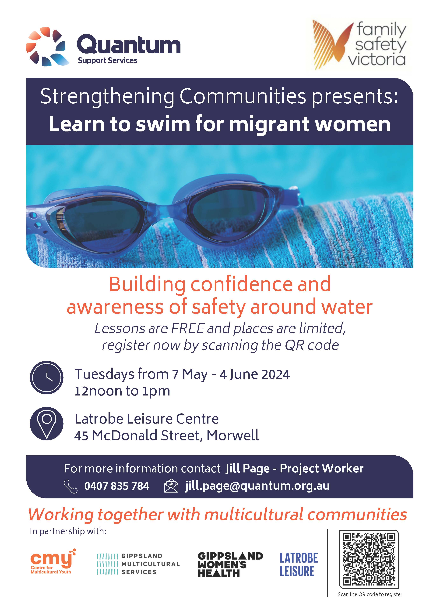
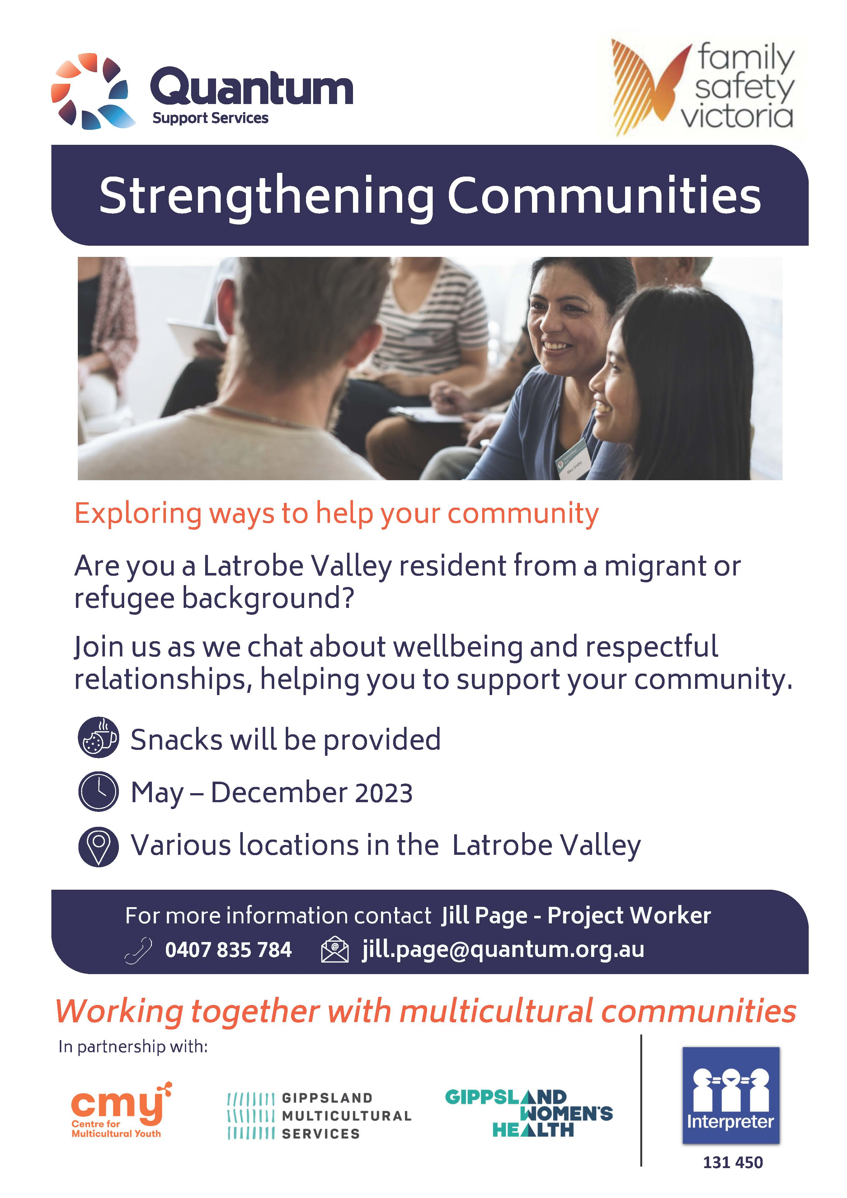

Slide 6
Project Insights
Terminologies:
Using the term Multicultural instead of CALD (culturally and linguistically diverse) in describing the target cohorts.
One may also use the term “migrant and refugees” to account for the person’s origins and journey to Australia.
“English as Additional Language” over “English as Second Language” in describing people from non-English speaking backgrounds.
Using the term cultural background instead of race or ethnicity, or Country of birth as proxy*.
Approach:
We have approached the issue of family violence within a comprehensive framework that considers health, wellbeing, and safety across various spheres of life, including home, work, and the broader community.
Learning about cultural humility and cultural safety instead of cultural competency.
Some of our findings

